Slide 1



Exhaustive Analysis of Indian Agriculture
by
Bhanu Sankar

Slide 2

Learning Objectives
To analyze key agricultural trends in India using Power BI.
To visualize and interpret agricultural data for better
decision-making.
To identify challenges and opportunities in Indian agriculture through data-driven insights.
To develop proficiency in Power BI for real-time agricultural analytics.
To generate interactive reports and dashboards for effective storytelling.
GOAL
Source :
www.freepik.com/

Slide 3
Tools and Technology used
Power BI – For data visualization, dashboard creation, and analysis.
Microsoft Excel / SQL – For data preprocessing and structuring (if applicable).
Kaggle - For getting data sets(information) about the topic .
DAX (Data Analysis Expressions) – Used for creating custom calculations in Power BI.
Data Sources – Government agricultural reports, crop yield data, weather datasets, etc.

Slide 4
Methodology
Data Collection – Gathering agricultural data from government sources, reports, and open
datasets.
Data Cleaning & Transformation – Preprocessing raw data using Power Query to remove
inconsistencies.
Data Modeling – Establishing relationships between different datasets to enable deep analysis.
Visualization & Dashboard Creation – Designing interactive dashboards to track agricultural
trends, crop yield, production, and challenges.
Insights & Analysis – Interpreting key findings to support agricultural policy-making and
recommendations.

Slide 5
Problem Statement:
The Indian agriculture sector faces challenges such as low productivity, climate dependency, and inefficient resource allocation. The lack of real-time data-driven insights makes it difficult for policymakers and farmers to make informed decisions. A unified analytical platform is needed to track crop production, weather impact, and market trends effectively.

Slide 6
Solution:
Using Power BI to develop a comprehensive dashboard that consolidates agricultural data into meaningful insights.
Visualizing crop production trends, land usage, weather impact, and farmer productivity.
Implementing interactive reports for policymakers and stakeholders to make informed decisions.
Enabling real-time monitoring of agricultural performance for proactive decision-making.

Slide 7
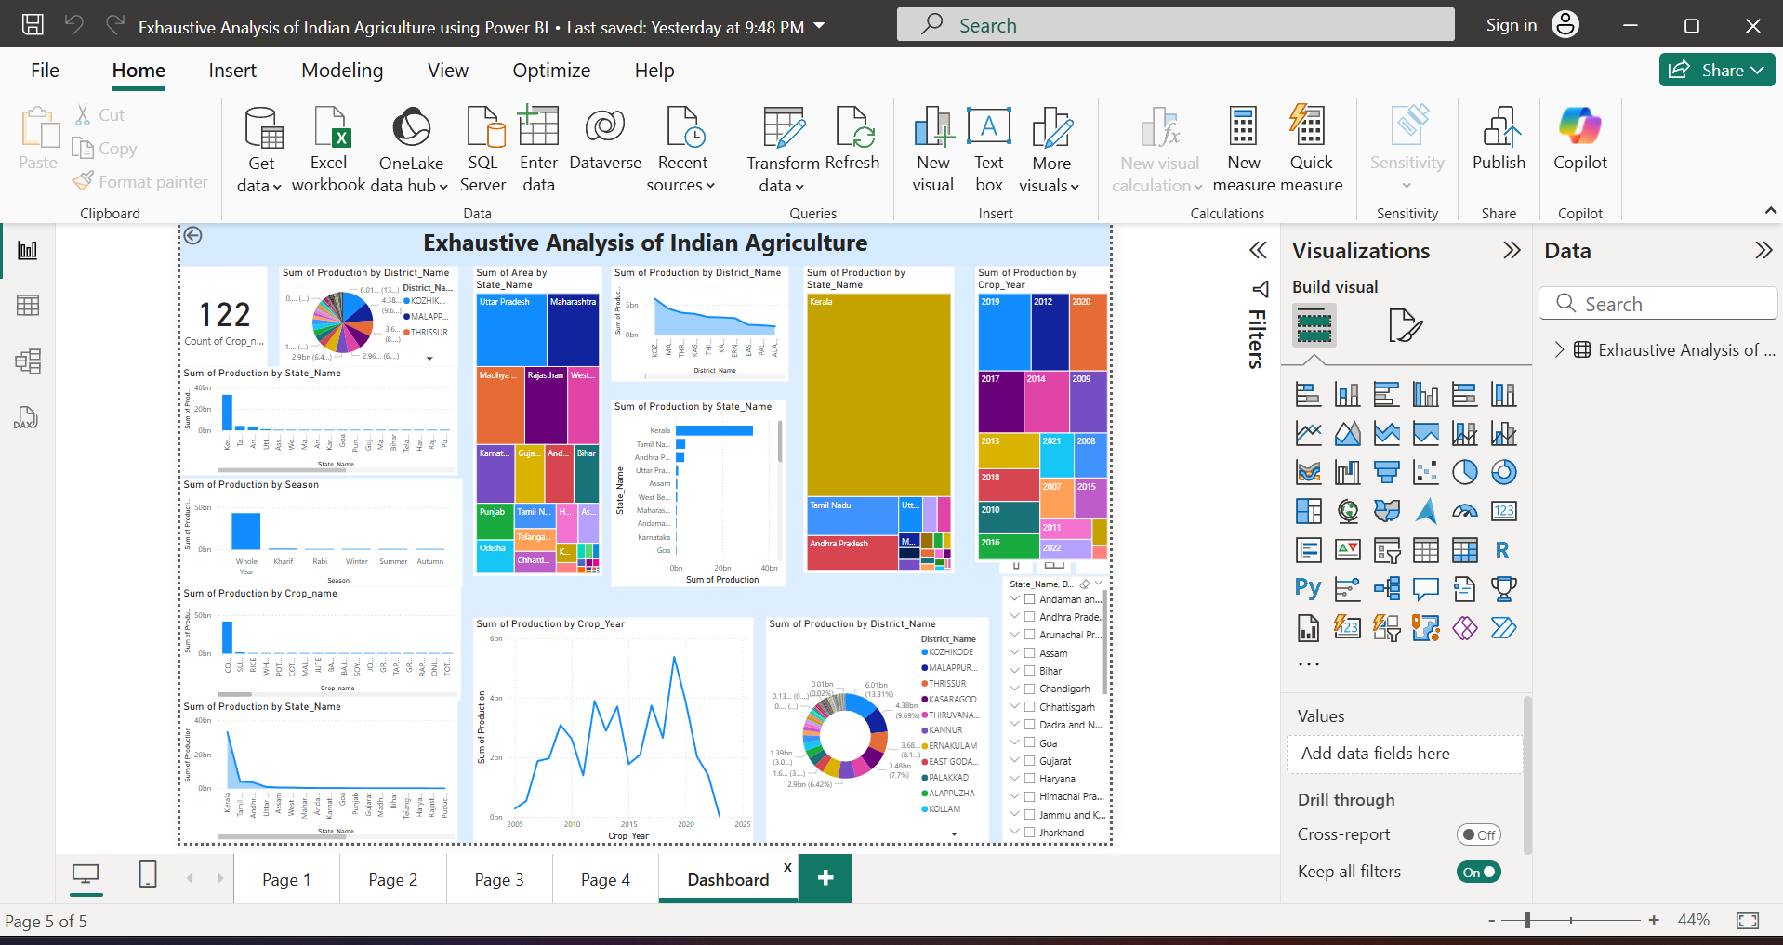
Screenshot of Output:

Slide 8
Conclusion:
Power BI provides a powerful platform for analyzing and visualizing Indian agricultural data, enabling data-driven decision-making. The insights generated can help improve productivity, optimize resource allocation, and mitigate risks. By leveraging interactive dashboards, policymakers and farmers can make informed decisions for sustainable agricultural growth. Future enhancements can include AI-powered predictive analytics for better forecasting and climate adaptation.

